Slide 1
Text Splitter

Slide 2


Document
Loader
Text
Splitter
Text chunks
PDF
Loaded PDF
embedding model
Embeddings
Vector Database
embedding model
Retriever
+
Final output
user query
Embeddings
Semantic search
Result chunks + user query
LLM

Slide 3
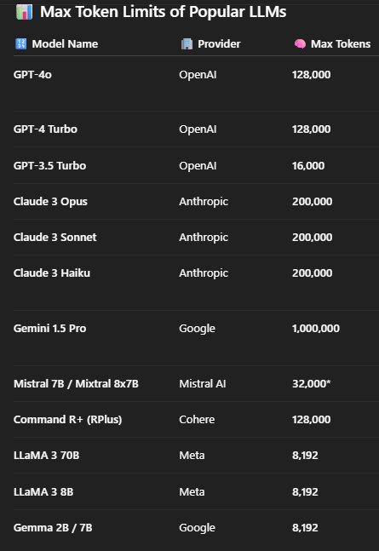
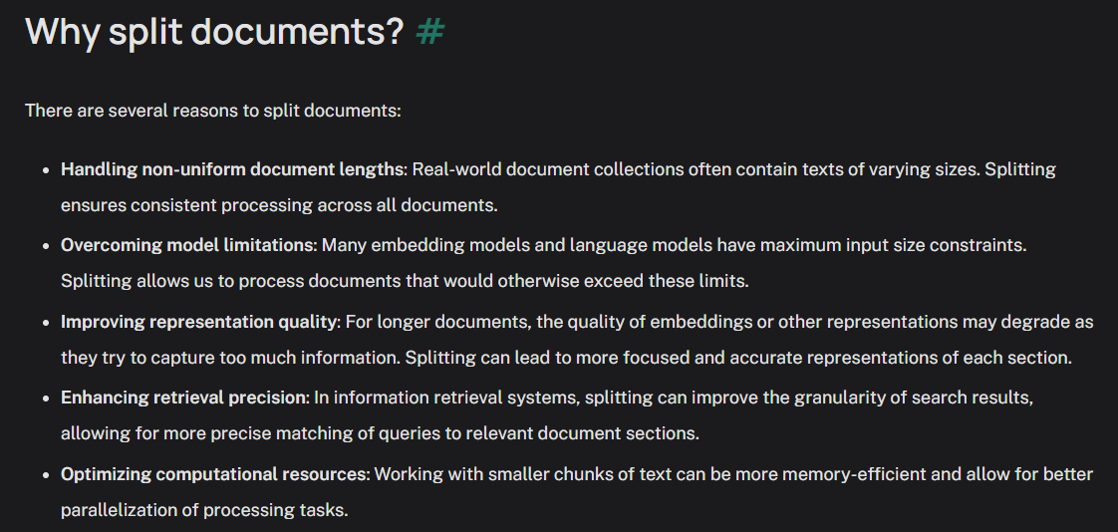
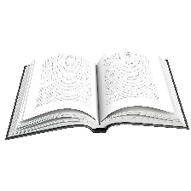

In LangChain, a Text Splitter is used to break long documents into smaller, manageable chunks that can be effectively processed by a language model (LLM) — especially for tasks like embeddings, retrieval, summarization, or question answering.

Slide 4
Length-based
Text-structured based
Text splitters
Document-structured based
Semantic meaning based
https://python.langchain.com/docs/concepts/text_splitters/#approaches

Slide 5
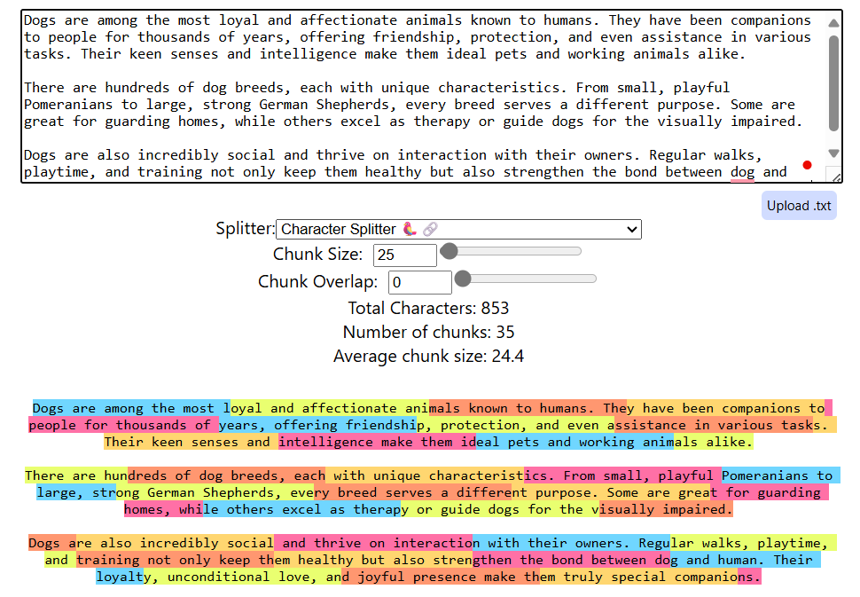
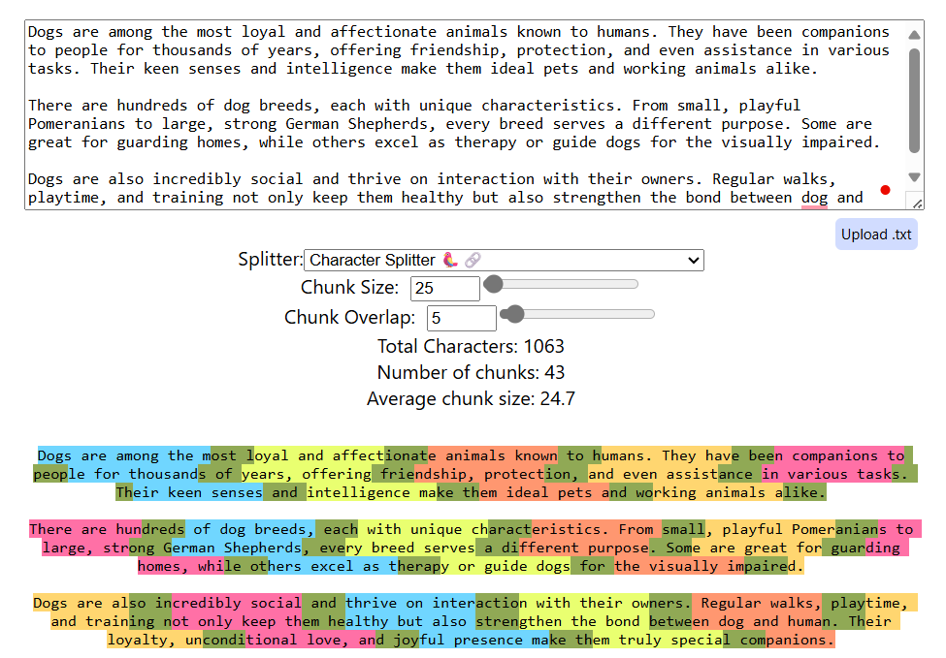
Length-based Text Splitter:
A Length-Based Text Splitter is a component in LangChain that splits large documents into smaller chunks based on a fixed length, which can be either: Character count (e.g., 500 characters per chunk), or Token count (e.g., 300 tokens per chunk) without trying to preserve sentences, paragraphs, or semantic structure.
Online demo: ChunkViz

Slide 6
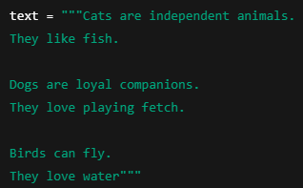
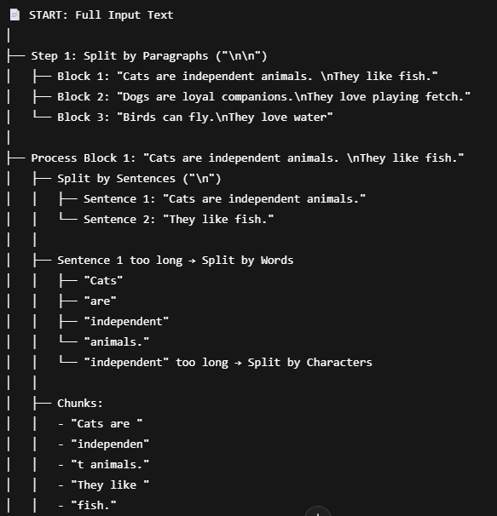
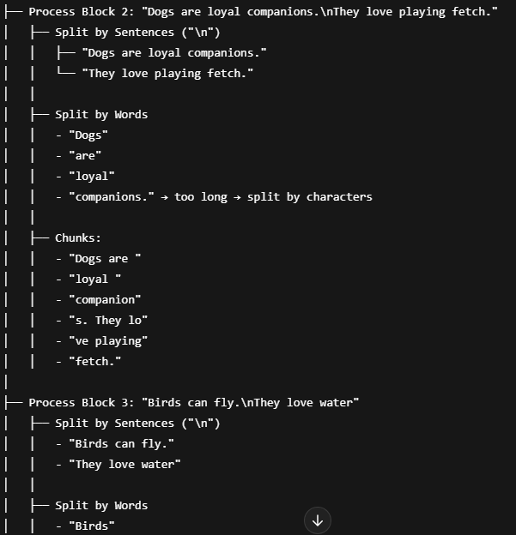
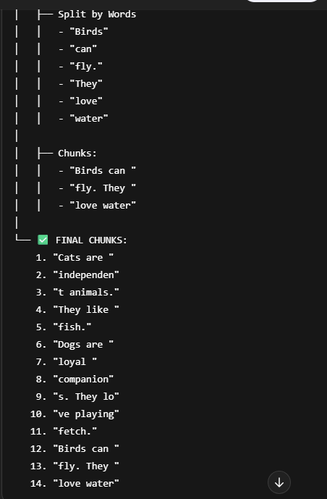
A Text-Structured Based Text Splitter splits a large document using natural language structures—such as paragraphs → sentences → words → characters—in order of priority. It ensures chunks stay within a size limit while preserving as much semantic meaning and readability as possible.
Text-structured based Text Splitter:
Word combinations fit size

Slide 7
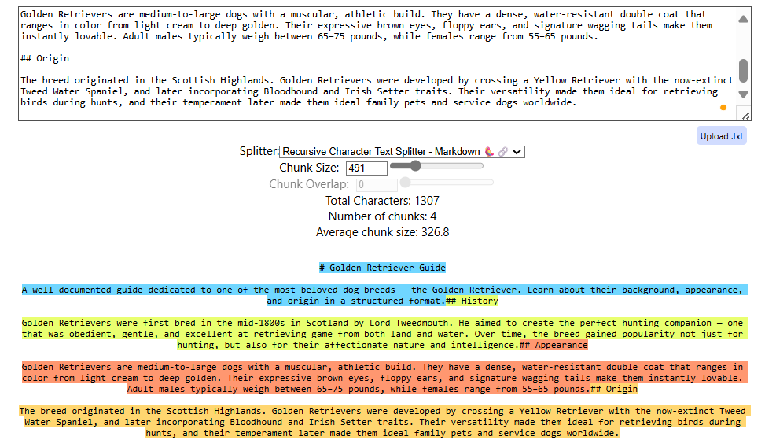
A Document-Structured Based Splitter is a technique in LangChain where documents are split based on their inherent structure, such as HTML, Markdown, JSON or Python files, etc., instead of just character or sentence boundaries.
Document-structured based Text Splitter:
text = """
# Golden Retriever Guide
A well-documented guide dedicated to one of the most beloved dog breeds — the Golden Retriever. Learn about their background, appearance, and origin in a structured format.
## History
Golden Retrievers were first bred in the mid-1800s in Scotland by Lord Tweedmouth. He aimed to create the perfect hunting companion — one that was obedient, gentle, and excellent at retrieving game from both land and water. Over time, the breed gained popularity not just for hunting, but also for their affectionate nature and intelligence.
## Appearance
Golden Retrievers are medium-to-large dogs with a muscular, athletic build. They have a dense, water-resistant double coat that ranges in color from light cream to deep golden. Their expressive brown eyes, floppy ears, and signature wagging tails make them instantly lovable. Adult males typically weigh between 65–75 pounds, while females range from 55–65 pounds.
## Origin
The breed originated in the Scottish Highlands. Golden Retrievers were developed by crossing a Yellow Retriever with the now-extinct Tweed Water Spaniel, and later incorporating Bloodhound and Irish Setter traits. Their versatility made them ideal for retrieving birds during hunts, and their temperament later made them ideal family pets and service dogs worldwide.
"""
Markdown

Slide 8
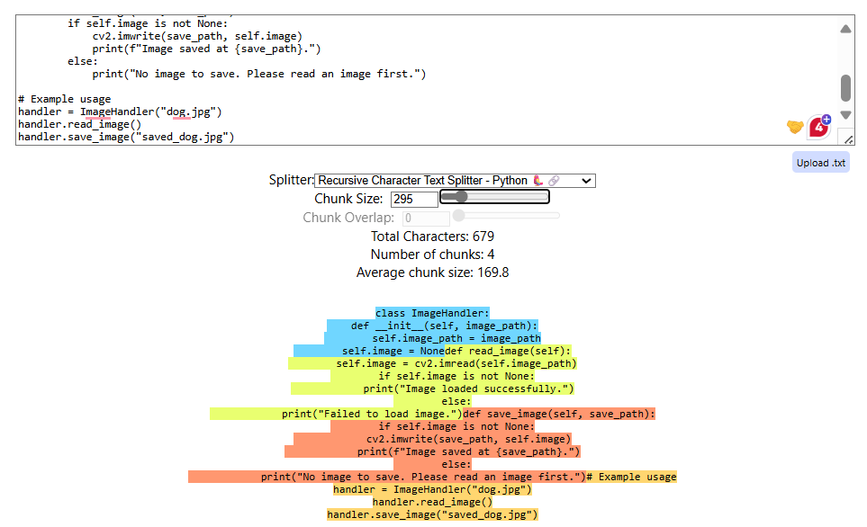
Python files
text = """
class ImageHandler:
def __init__(self, image_path):
self.image_path = image_path
self.image = None
def read_image(self):
self.image = cv2.imread(self.image_path)
if self.image is not None:
print("Image loaded successfully.")
else:
print("Failed to load image.")
def save_image(self, save_path):
if self.image is not None:
cv2.imwrite(save_path, self.image)
print(f"Image saved at {save_path}.")
else:
print("No image to save. Please read an image first.")
# Example usage
handler = ImageHandler("dog.jpg")
handler.read_image()
handler.save_image("saved_dog.jpg")
"""

Slide 9
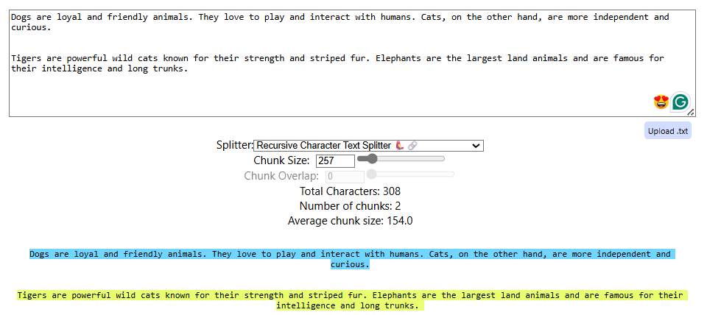
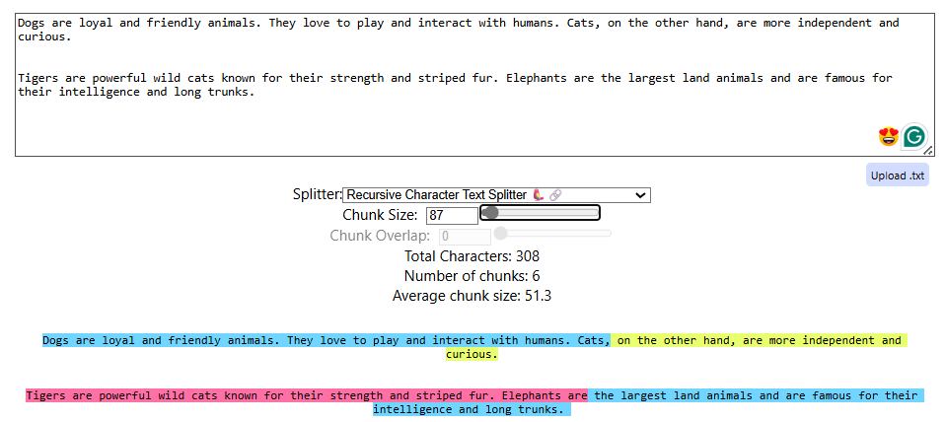
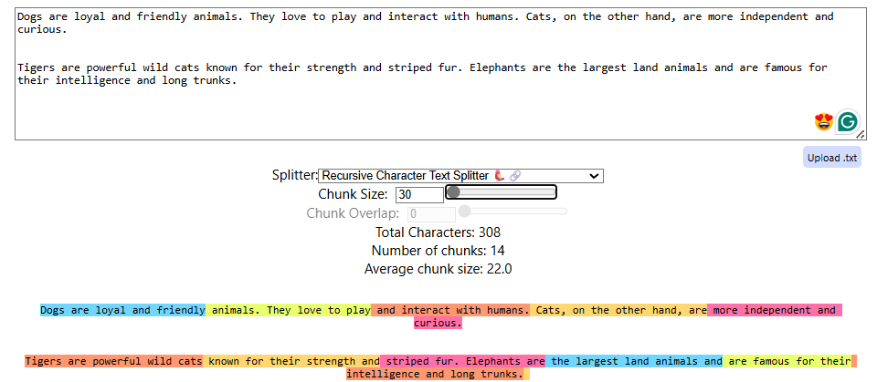
A Semantic Meaning-Based Text Splitter breaks down large texts into smaller chunks based on meaning, rather than just character count, sentence boundaries, or tokens.
Semantic meaning based Text Splitter:
Why do we need it?

Slide 10
A Semantic Meaning-Based Text Splitter breaks down large texts into smaller chunks based on meaning, rather than just character count, sentence boundaries, or tokens.
Semantic meaning based Text Splitter:
Chunk-1
Chunk-2
Embeddings
s1
s2
s3
s4
s5
Cosine similarity
0.9
0.8
0.3
0.75
compute the standard deviation of similarities. If a similarity drop is more than n×std deviation → It's considered a semantic breakpoint
Dogs are loyal and friendly animals. They love to play and interact with humans. Cats, on the other hand, are more independent and curious.
Tigers are powerful wild cats known for their strength and striped fur. Elephants are the largest land animals and are famous for their intelligence and long trunks.

Slide 12
THANK YOU FOR YOUR TIME

